Slide 1
Carpinteria Coworking Space Market Feasibility Study
Authored by Taylor Hughes
April 11, 2018

Slide 2
Introduction
A colleague and myself wish to explore the option of opening a Coworking Space in Carpinteria, CA – a small municipality just down the coast from Santa Barbara, CA
My project revolves around taking a 1% Census sample of the surrounding market areas in order to determine if regional demographics suggest that my business will be successful
Training data will be constructed from results of the 2017 Global Coworking Survey and the rest from the Los Angeles Census.
The end result will be individual scores assigned to every market-area Census respondent in a linear regression. Scores will be between 0 and 1.

Slide 3
2017 Global Coworking Survey

Slide 4
2017 Global Coworking Survey

Slide 5
Data Wrangling
Data was taken from the 2016 US Census PUMS data – a sampling of 1%of demographic information of individuals of the US Population.
Data Wrangling in this sense consists of deciding which areas to select from and re-formatting all Census data in a manner uniform and equally meaningful to the 2017 Global Coworking Survey.
Most Data Wrangling in this project was simple classification of Census Data into categories presented by the Global Coworking Survey. However there were some more nuanced problems:
The Census anonymizes location of individuals – can we simulate where people live in order to get a sense of distance to the Coworking Space and refine our Marketing Plan?
How do we extend distance to our specific Coworking Space in Carpinteria to a training set indicative of a general demographic elsewhere in a meaningful way?

Slide 6
Classification of data into factors
INTEGER
The following fields of the 2016 PUMS Census must be translated into factors correlating to those on slides 3-4:
Mode of Transportation
Travel Time to Work:
Job Type
Occupation
Gender
Marital Status
Health Insurance Status
Current Workspace
Education information
Income Information
FACTOR

Slide 7
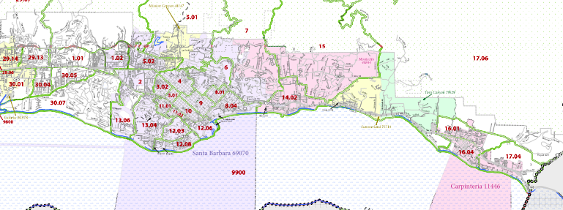
Commute Time to Coworking Space – Market Area Data
Proposed Coworking Location

Slide 8
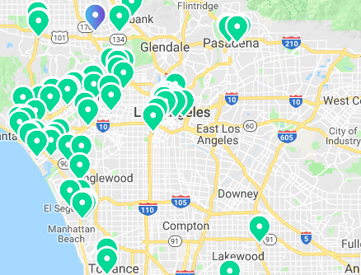
Commute Time to Any Coworking Space – Los Angeles Training Data
Within a 20 minute drive time to Coworking Space, therefore CommuteTime = “Yes”
Not within a 20 minute drive to a Coworking Space, therefore CommuteTime = “No”
In order to minimize our limited calls to Google Maps API, I have computed the Euclidean distances between each Census Tract and each Coworking Space. I have computed drive time between each Census Tract and its geographically closest Coworking Space. This is ported to each individual LA County Census observation as a “Yes” or “No” for 20-minute drive time to any Coworking Space.

Slide 9
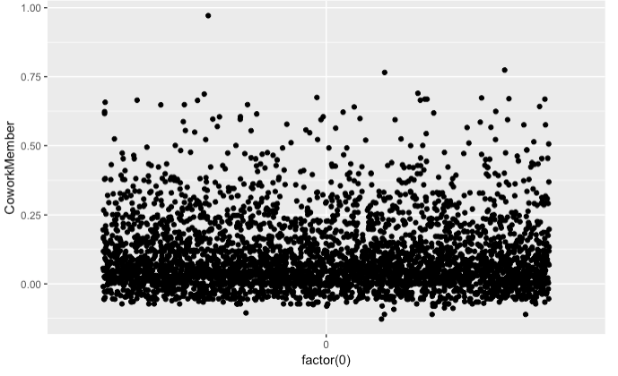
Analysis of the coworking scores – Target Area
Very Likely
Somewhat Likely
Not Likely

Slide 10
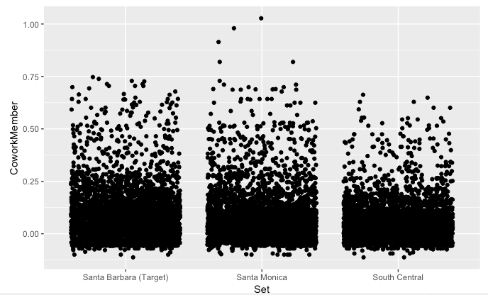
Comparison of all three test sites

Slide 11
Conclusions
We see that the Santa Barbara Market Area actually has more people than Santa Monica that are categorized as “Somewhat Likely” which is a really good indication of strong customer potentiality in that region.
However, Santa Monica has a much higher max potentiality for the upper echelon customers.
Clearly Santa Barbara Market Areas have a much higher customer potentiality than the Compton/Rancho Dominguez area which has been classified as a poor customer potentiality area.
I believe that according to this model, Our proposed location would be a good fit for a Coworking Space. Since the maximum potentiality is lower than in a known strong market area, however, I believe the scope of the project should be considered more of a boutique operation instead of a full fledged space.
I recommend that the project moves forward

Slide 12
What’s next?
Now that we have our answer, what’s next to be done with the data?
The next very useful operation to perform would be to create a readout of what Census Tracts have the strongest customer potentiality. This should be accompanied by a heat-map diagram split up by Census Tract.
Next, there should be an analysis of the impact of local competition. Are there competitors nearby that suck up Market Share? How close are they to our space? We should re-run an analysis of CommuteTime, this time incorporating other Santa Barbara area Coworking Spaces into our data set using my partnership with Coworker.com.

